Slide 2


It’s me
Natarajan Ganapathi
AI Engineer
About Me
Architected cloud-native, full-stack, and GenAI solutions – Microservices, DevOps, Azure, Agent Development, Multi-tenant Apps #Azure #Cloud #DevOps #GenAI #AIAgent
linkedin.com/in/natarajanganapathi

Slide 3
AI Agents Build, Orchestrate and Scale with Microsoft Agent Framework & Azure AI Foundry

Slide 4
Agenda
Overview
What is AI Agent
Azure AI Foundry
Open AI Models
AI Agent Service
Microsoft Agent Framework
AI Agent Development
Architecture Overview
RAG
Multi-Agent Workflow & Patterns
Single & Multi Agent
Agent categories

Slide 5

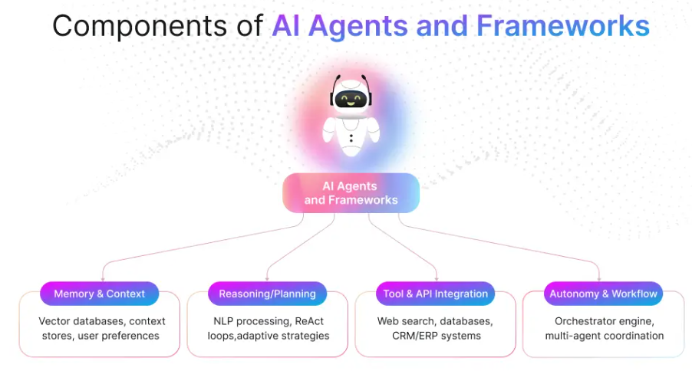
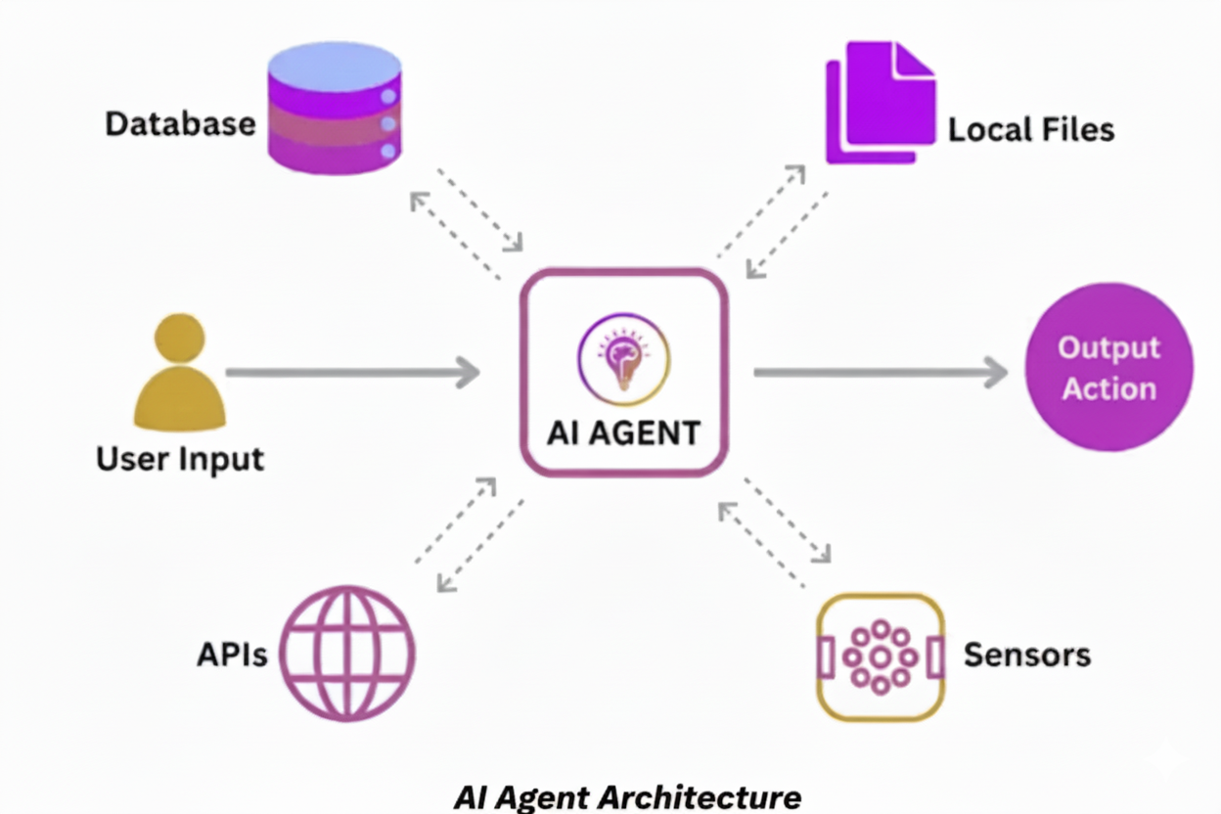
What is AI Agent
An AI agent is a software program that uses artificial intelligence techniques to understand the situation, make decisions, and take actions to achieve specific goals.

Slide 6
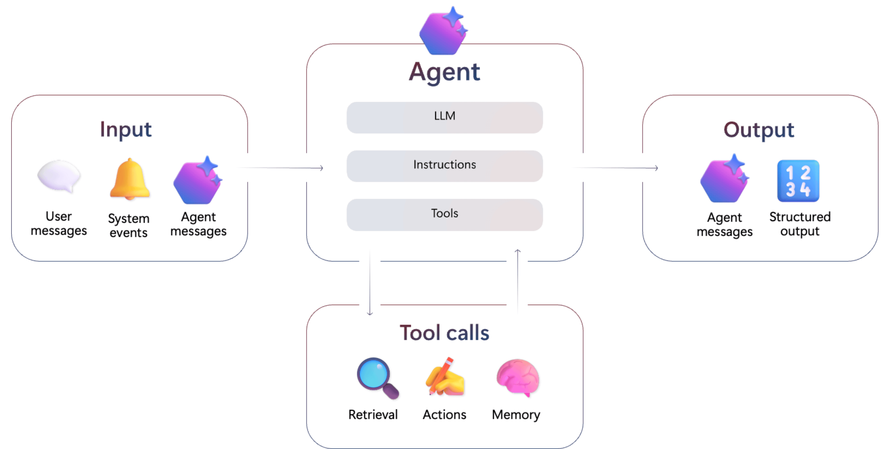
Architecture Overview

Slide 7
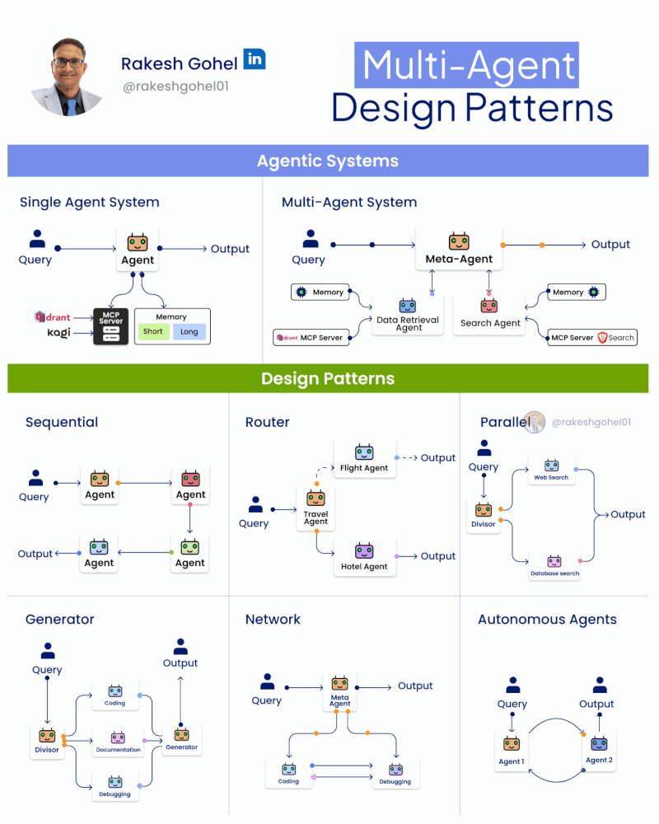
Single & Multi Agent

Slide 8
Azure AI Foundry

Slide 9

Using Azure
AI Foundry Agent Service

Slide 10
Microsoft Agent Framework

Slide 11


Slide 12
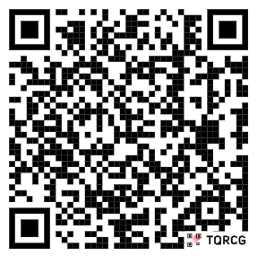
The source code can be found at
github.com/natarajanganapathi/TechXConf-2025.git

Slide 13
Agent categories
Task
Tool-Using
Multi-Modal
Orchestrator
Conversational
Role-Based
Custom
Agent Types
Persistent
Stateless
Session-Based
Tool-Enabled
Autonomous
Multi-Agent
Event-Driven
Hybrid

Slide 14
Multi-Agent Workflow & Patterns
dotnet add package Microsoft.Agents.AI.Workflows --prerelease

Slide 15
Key Takeaways
Agent Creation using Azure AI Foundry Agent Service
Agent Creation Using Microsoft Agent Framework
Enabling Observability for Agents
Expose an Agent as an MCP Tool

Slide 16

Thank You!
Natarajan Ganapathi
Connect with me in LinkedIn
linkedin.com/in/natarajanganapathi

Slide 17
Agent Category | Commonly Associated Agent Types | Notes/Examples
Task Agent | Stateless, Session-Based, Persistent | Can be stateless for simple tasks, session-based for multi-turn, or persistent for complex tasks.
Tool-Using Agent | Tool-Enabled, Persistent, Stateless, Session-Based | Often tool-enabled; may be persistent if tool use requires memory/context.
Multi-Modal Agent | Persistent, Session-Based, Tool-Enabled | Needs context/memory for handling multiple modalities; often tool-enabled.
Orchestrator Agent | Multi-Agent Orchestrator, Persistent | Manages other agents; usually persistent to track workflows and agent states.
Conversational Agent | Session-Based, Persistent, Stateless | Session-based for chat context, persistent for long-term memory, stateless for simple Q&A.
Role-Based Agent | Persistent, Session-Based, Stateless | Role can be assigned to any type; persistent/session-based for maintaining persona/context.
Custom Agent | Any (Persistent, Stateless, Session-Based, Tool-Enabled, etc.) | Custom agents can combine any types as needed for the use case.

